Slide 1

Why Rails Makes Startups
The Lean Startup
#leanstartup
Eric Ries (@ericries)
http://StartupLessonsLearned.com

Slide 2
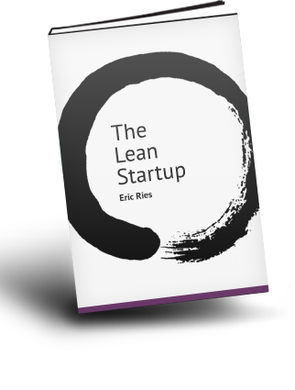
http://lean.st

Slide 3


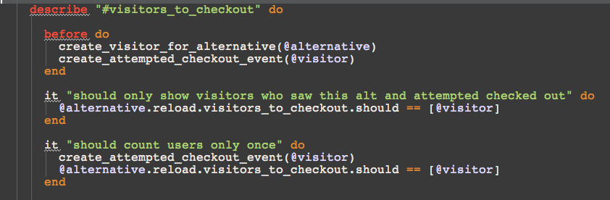
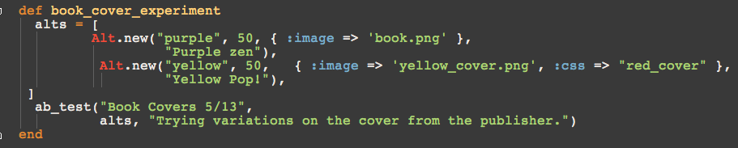
Watch what happens behind the scenes & see every experiment we’ve run at: http://lean.st

Slide 4
Lean Startup Principles
Entrepreneurs are everywhere
Entrepreneurship is management
Validated Learning
Build – Measure - Learn
Innovation Accounting

Slide 5
Lean Startup Principles
Entrepreneurs are everywhere

Slide 6
What is a startup?
A startup is a human institution designed to deliver a new product or service under conditions of extreme uncertainty.
Nothing to do with size of company, sector of the economy, or industry

Slide 7
What is a startup?
STARTUP
=
EXPERIMENT

Slide 8
STOP
WASTING
PEOPLE’S
TIME

Slide 9
Most Startups Fail

Slide 10
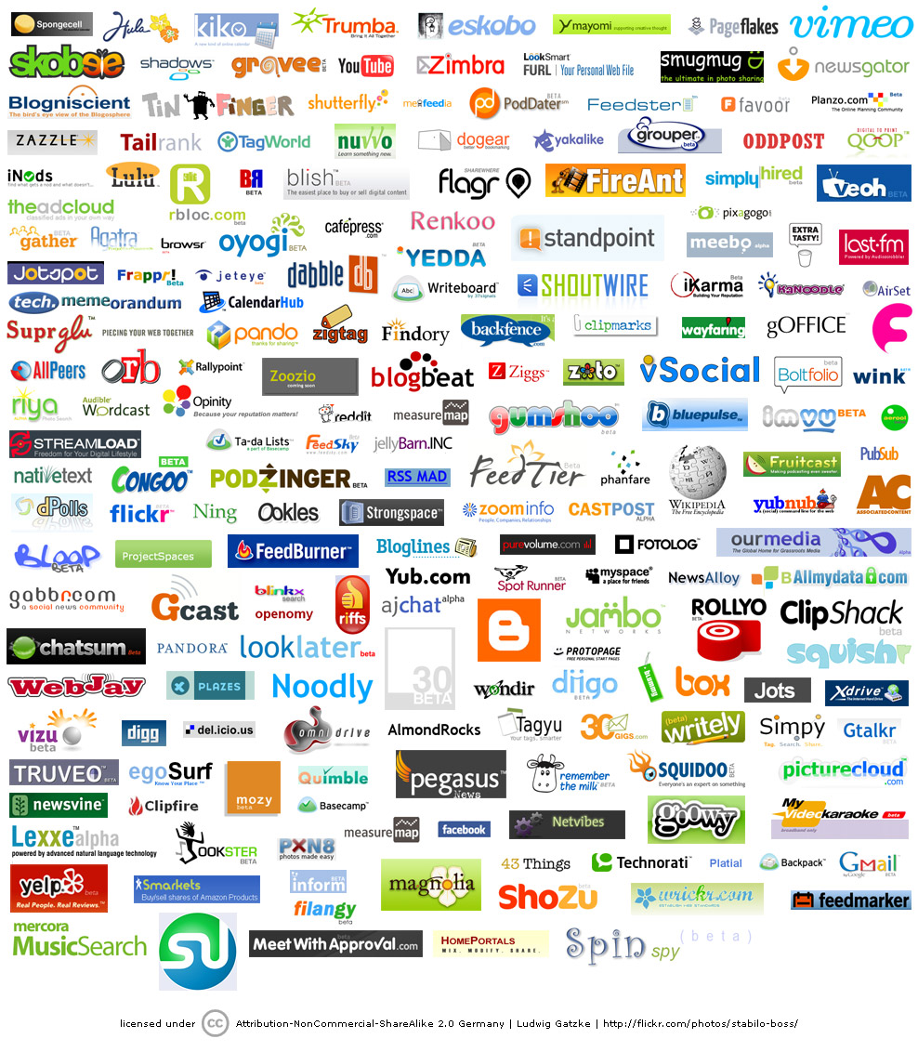
Most Startups Fail

Slide 11
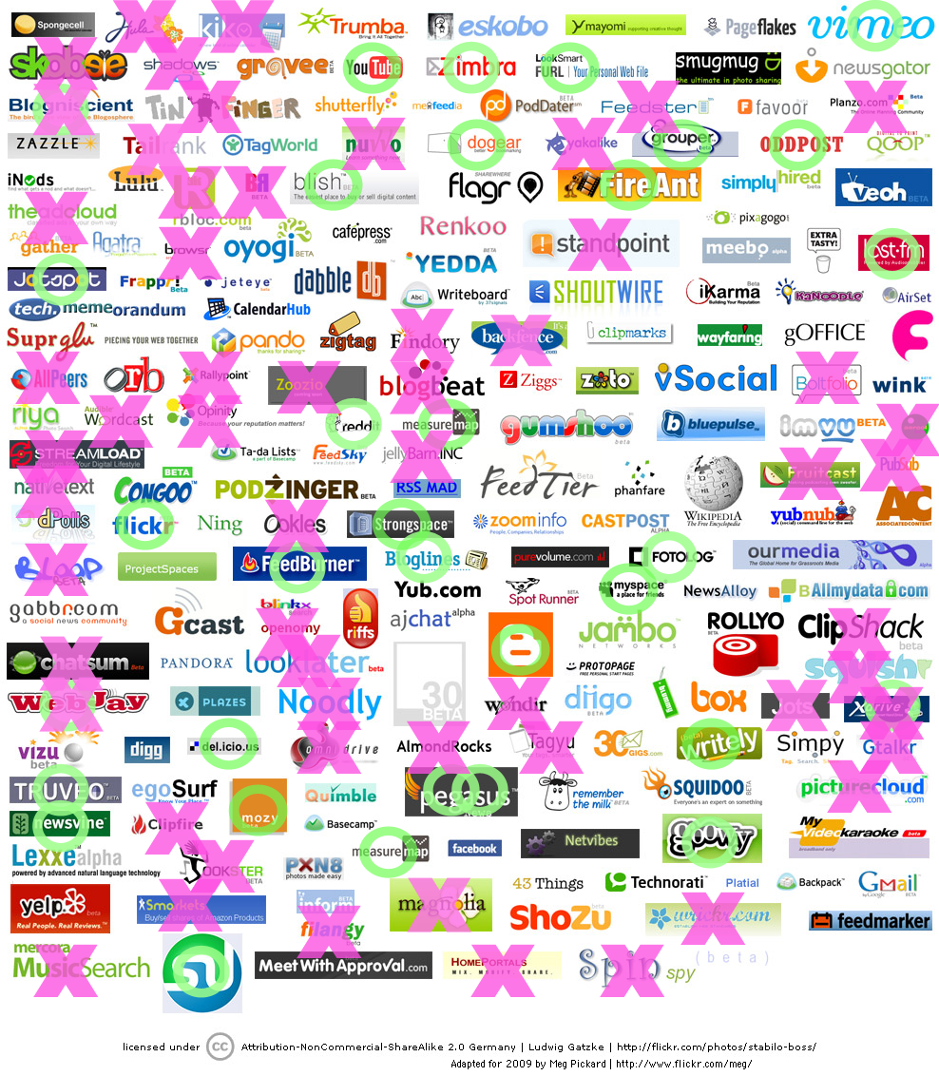
Most Startups Fail

Slide 12
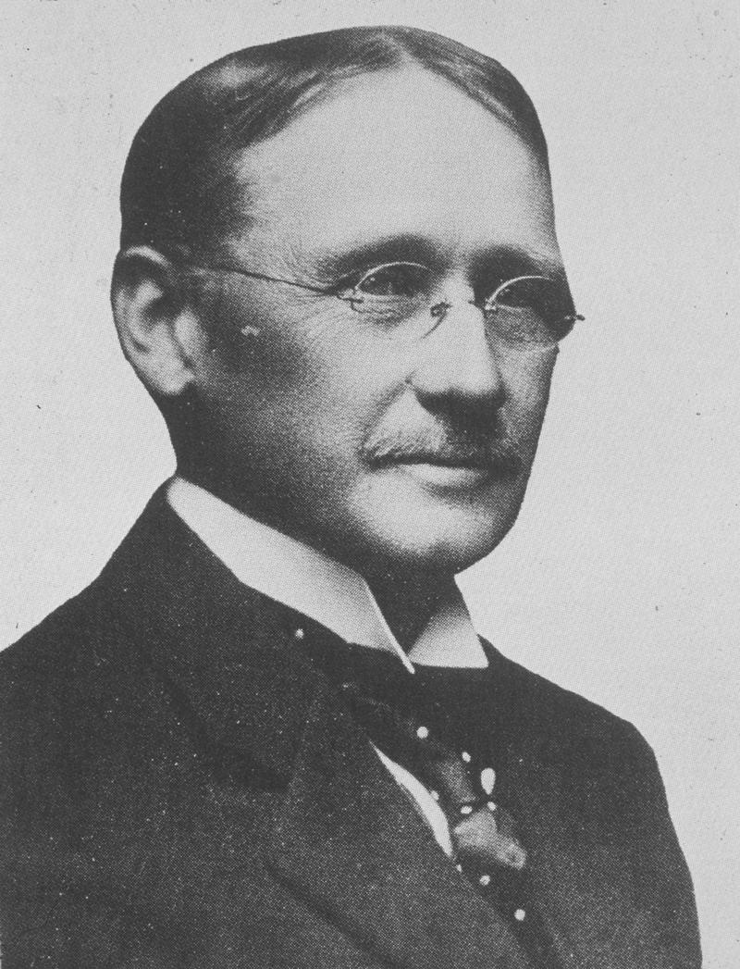
Who to Blame
Father of scientific management
Study work to find the best way
Management by exception
Standardize work into tasks
Compensate workers based on performance
“In the past, the man was first. In the future, the system will be first.” (1911)
Frederick Winslow Taylor
(1856 – 1915)

Slide 13
Lean Startup Principles
Entrepreneurs are everywhere
Entrepreneurship is management

Slide 14
Entrepreneurship is management
Our goal is to create an institution, not just a product
Traditional management practices fail
  - “general management” as taught to MBAs
Need practices and principles geared to the startup context of extreme uncertainty
Not just for “two guys in a garage”

Slide 15
The Pivot

Slide 16
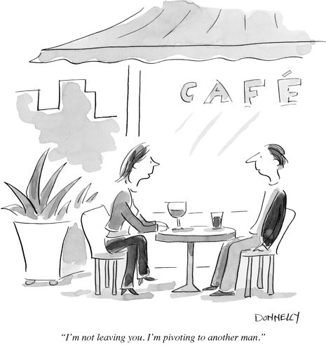
I’
Notes:
I’m not leaving you, I’m pivoting to another man

Slide 17
The Pivot
What do successful startups have in common?
  They started out as digital cash for PDAs, but evolved into online payments for eBay.
  They started building BASIC interpreters, but evolved into the world's largest operating systems monopoly.
  They were shocked to discover their online games company was actually a photo-sharing site.
Pivot: change directions but stay grounded in what we’ve learned.

Slide 18
Speed Wins
If we can reduce the time between pivots
We can increase our odds of success
Before we run out of money

Slide 19
Lean Startup Principles
Entrepreneurs are everywhere
Entrepreneurship is management
Validated Learning

Slide 20
Traditional Product Development
Unit of Progress: Advance to Next Stage
Waterfall
Requirements
Specifications
Design
Problem: known
Solution: known
Implementation
Verification
Maintenance

Slide 21
Achieving Failure
If we’re building something nobody wants, what does it matter if we accomplish it:
On time?
On budget?
With high quality?
With beautiful design?
Achieving Failure = successfully executing a bad plan

Slide 22

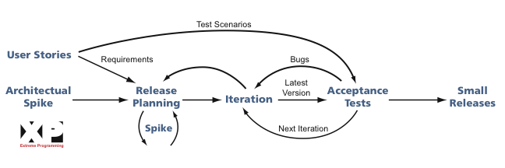

Agile Product Development
Unit of Progress: A line of Working Code
“Product Owner” or in-house customer
Problem: known
Solution: unknown
Kent Beck
(still alive)

Slide 23

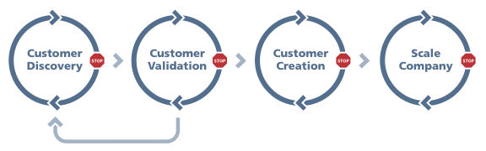
Lean Startup
Unit of Progress: Validated Learning
Steve Blank
(still alive)
Customer Development
Hypotheses, Experiments,
Insights
Problem: unknown
Solution: unknown
Data, Feedback,
Insights
Agile Development

Slide 24
Lean Startup Principles
Entrepreneurs are everywhere
Entrepreneurship is management
Validated Learning
Build – Measure - Learn

Slide 25
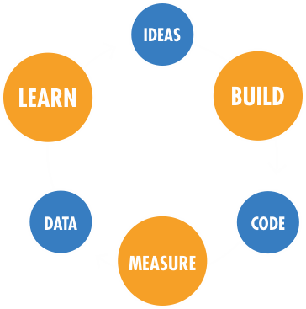
Minimize TOTAL time through the loop

Slide 26
There’s much more…
Learn Faster
Split Tests
Customer Development
Five Whys
Customer Advisory Board
Falsifiable Hypotheses
Product Owner
Accountability
Customer Archetypes
Cross-functional Teams
Semi-autonomous Teams
Smoke Tests
Build Faster
Unit Tests
Usability Tests
Continuous Integration
Incremental Deployment
Free & Open-Source
Cloud Computing
Cluster Immune System
Just-in-time Scalability
Refactoring
Developer Sandbox
Minimum Viable Product
Measure Faster
Split Tests
Continuous Deployment
Usability Tests
Real-time Monitoring & Alerting
Customer Liaison
Measure Faster
Funnel Analysis
Cohort Analysis
Net Promoter Score
Search Engine Marketing
Predictive Monitoring
Notes:
Conference structure

Slide 27
Lean Startup Principles
Entrepreneurs are everywhere
Entrepreneurship is management
Validated Learning
Build – Measure - Learn
Innovation Accounting

Slide 28
Innovation Accounting
The Three Learning Milestones
Establish the baseline
  Build a minimum viable product
  Measure how customers behave right now
Tune the engine
  - Experiment to see if we can improve metrics from the baseline towards the ideal
Pivot or persevere
  - When experiments reach diminishing returns, it’s time to pivot.

Slide 29
Questions
How do we know when to pivot?
Vision or Strategy or Product?
What should we measure?
How do products grow?
Are we creating value?
What’s in the MVP?
Can we go faster?

Slide 31
Thanks!
Buy the book @ http://lean.st
Startup Lessons Learned Blog
  http://StartupLessonsLearned.com
Getting in touch (#leanstartup)
  http://twitter.com/ericries
  eric@theleanstartup.com
Additional resources
  NEW: http://theleanstartup.com
  SLLCONF 2011: http://sllconf.com May 23 in SF

Slide 32
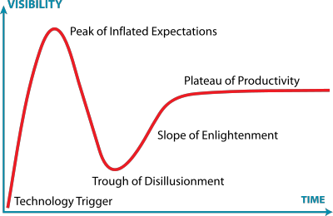

Slide 33
Myth #1
Myth
Lean means cheap. Lean startups try to
spend as little money as possible.
Truth
The Lean Startup method is not about cost,
it is about speed.
Notes:
Truth: The Lean Startup method is not about cost, it is about speed. Lean Startups waste less money, because they use a disciplined approach to testing new products and ideas. Lean, when used in the context of lean startup, refers to a process of building companies and products using lean manufacturing principles applied to innovation. That process involves rapid hypothesis testing, validated learning about customers, and a disciplined approach to product development.

Slide 34
Myth #2
Myth
The Lean Startup is only for
Web 2.0/internet/consumer software companies.
Truth
The Lean Startup applies to all companies that face uncertainty about what customers will want.
Notes:
Truth: The Lean Startup methodology applies to all companies that face uncertainty about what customers will want. This is true regardless of industry or even scale of company: many large companies depend on their ability to create disruptive innovation. Those general managers are entrepreneurs, too. And they can benefit from the speed and discipline of starting with a minimum viable product and then learning and iterating continuously.

Slide 35
Myth #3
Myth
Lean Startups are small bootstrapped startups.
Truth
Lean Startups are ambitious and are able
to deploy large amounts of capital.
Notes:
Truth: There’s nothing wrong with raising venture capital. Many lean startups are ambitious and are able to deploy large amounts of capital. What differentiates them is their disciplined approach to determining when to spend money: after the fundamental elements of the business model have been empirically validated. Because lean startups focus on validating their riskiest assumptions first, they sometimes charge money for their product from day one – but not always.

Slide 36
Myth #4
Myth
Lean Startups replace vision with data
or customer feedback.
Truth
Lean Startups are driven by a compelling vision, and are rigorous about testing each element of this vision
Notes:
Truth: Lean Startups are driven by a compelling vision, and they are rigorous about testing each element of this vision against reality. They use customer development, split-testing, and actionable analytics as vehicles for learning about how to make their vision successful. But they do not blindly do what customers tell them, nor do they mechanically attempt to optimize numbers. Along the way, they pivot away from the elements of the vision that are delusional and double-down on the elements that show promise.

Slide 37
Lean Startup Principles
Entrepreneurs are everywhere
Entrepreneurship is management
Validated Learning
Build – Measure - Learn
Innovation Accounting

Slide 38
Minimum Viable Product
Visionary customers can “fill in the gaps” on missing features, if the product solves a real problem
Allows us to achieve a big vision in small increments without going in circles
Requires a commitment to iteration
MVP is only for BIG VISION products; unnecessary for minimal products.

Slide 39
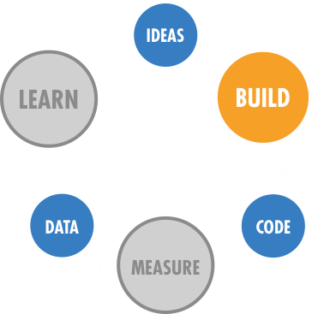
Continuous Deployment
Learn Faster
Customer Development
Five Whys
Build Faster
Continuous Deployment
Small Batches
Minimum Viable Product
Refactoring
Measure Faster
Split Testing
Actionable Metrics
Net Promoter Score
SEM

Slide 40
Continuous Deployment Principles
Have every problem once
Stop the line when anything fails
Fast response over prevention

Slide 41
Continuous Deployment
Deploy new software quickly
  At IMVU time from check-in to production = 20 minutes
Tell a good change from a bad change (quickly)
Revert a bad change quickly
  And “shut down the line”
Work in small batches
  At IMVU, a large batch = 3 days worth of work
Break large projects down into small batches

Slide 42
Cluster Immune System
What it looks like to ship one piece of code to production:
Run tests locally (SimpleTest, Selenium)
  Everyone has a complete sandbox
Continuous Integration Server (BuildBot)
  All tests must pass or “shut down the line”
  Automatic feedback if the team is going too fast
Incremental deploy
  Monitor cluster and business metrics in real-time
  Reject changes that move metrics out-of-bounds
Alerting & Predictive monitoring (Nagios)
  Monitor all metrics that stakeholders care about
  If any metric goes out-of-bounds, wake somebody up
  Use historical trends to predict acceptable bounds
When customers see a failure
  Fix the problem for customers
  Improve your defenses at each level

Slide 43
Minimum Viable Product
Learn Faster
Customer Development
Five Whys
Build Faster
Continuous Deployment
Small Batches
Minimum Viable Product
Refactoring
Measure Faster
Split Testing
Actionable Metrics
Net Promoter Score
SEM

Slide 44
Why do we build products?
Delight customers
Get lots of them signed up
Make a lot of money
Realize a big vision; change the world
Learn to predict the future

Slide 45
Possible Approaches
“Maximize chances of success”
  build a great product with enough features that increase the odds that customers will want it
  Problem: no feedback until the end, might be too late to adjust
“Release early, release often”
  Get as much feedback as possible, as soon as possible
  Problem: run around in circles, chasing what customers think they want

Slide 46
Minimum Viable Product
The minimum set of features needed to learn from earlyvangelists – visionary early adopters
  Avoid building products that nobody wants
  Maximize the learning per dollar spent
Probably much more minimum than you think!

Slide 47
Minimum Viable Product
Visionary customers can “fill in the gaps” on missing features, if the product solves a real problem
Allows us to achieve a big vision in small increments without going in circles
Requires a commitment to iteration
MVP is only for BIG VISION products; unnecessary for minimal products.

Slide 48
Techniques
Smoke testing with landing pages, AdWords
SEM on five dollars a day
In-product split testing
Paper prototypes
Customer discovery/validation
Removing features (“cut and paste”)

Slide 49
Fears
False negative: “customers would have liked the full product, but the MVP sucks, so we abandoned the vision”
Visionary complex: “but customers don’t know what they want!”
Too busy to learn: “it would be faster to just build it right, all this measuring distracts from delighting customers”

Slide 50
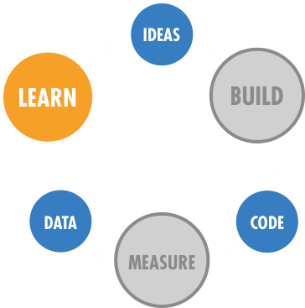
Five Whys
Learn Faster
Five Whys Root
Cause Analysis
Code Faster
Continuous Deployment
Measure Faster
Rapid Split Tests

Slide 51
Five Whys Root Cause Analysis
A technique for continuous improvement of company process.
Ask “why” five times when something unexpected happens.
Make proportional investments in prevention at all five levels of the hierarchy.
Behind every supposed technical problem is usually a human problem. Fix the cause, not just the symptom.

Slide 52
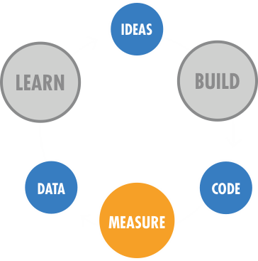
Rapid Split Tests
Learn Faster
Five Whys Root
Cause Analysis
Code Faster
Continuous Deployment
Measure Faster
Rapid Split Tests

Slide 53
Split-testing all the time
A/B testing is key to validating your hypotheses
Has to be simple enough for everyone to use and understand it
Make creating a split-test no more than one line of code:
    if( setup_experiment(...) == "control" ) {
    // do it the old way
    } else {
    // do it the new way
    }

Slide 54
The AAA’s of Metrics
Actionable
Accessible
Auditable

Slide 55
Measure the Macro
Always look at cohort-based metrics over time
Split-test the small, measure the large
 | Control Group (A) | Experiment (B)
# Registered | 1025 | 1099
Downloads | 755 (73%) | 733 (67%)
Active days 0-1 | 600 (58%) | 650 (59%)
Active days 1-3 | 500 (48%) | 545 (49%)
Active days 3-10 | 300 (29%) | 330 (30%)
Active days 10-30 | 250 (24%) | 290 (26%)
Total Revenue | $3210.50 | $3450.10
RPU | $3.13 | $3.14

Slide 56
Lean Startup Principles
Entrepreneurs are everywhere
Entrepreneurship is management
Validated Learning
Innovation Accounting

Slide 57
Minimum Viable Product
The minimum set of features needed to learn from earlyvangelists – visionary early adopters
  Avoid building products that nobody wants
  Maximize the learning per dollar spent
Probably much more minimum than you think!

Slide 58
Minimum Viable Product
Visionary customers can “fill in the gaps” on missing features, if the product solves a real problem
Allows us to achieve a big vision in small increments without going in circles
Requires a commitment to iteration
MVP is only for BIG VISION products; unnecessary for minimal products.

Slide 59
Split-testing all the time
A/B testing is key to validating your hypotheses
Has to be simple enough for everyone to use and understand it
Make creating a split-test no more than one line of code:
    if( setup_experiment(...) == "control" ) {
    // do it the old way
    } else {
    // do it the new way
    }

Slide 60
The AAA’s of Metrics
Actionable
Accessible
Auditable

Slide 61
Measure the Macro
Always look at cohort-based metrics over time
Split-test the small, measure the large
 | Control Group (A) | Experiment (B)
# Registered | 1025 | 1099
Downloads | 755 (73%) | 733 (67%)
Active days 0-1 | 600 (58%) | 650 (59%)
Active days 1-3 | 500 (48%) | 545 (49%)
Active days 3-10 | 300 (29%) | 330 (30%)
Active days 10-30 | 250 (24%) | 290 (26%)
Total Revenue | $3210.50 | $3450.10
RPU | $3.13 | $3.14

Slide 62
I’
Notes:
I’m not leaving you, I’m pivoting to another man

